Slide 1
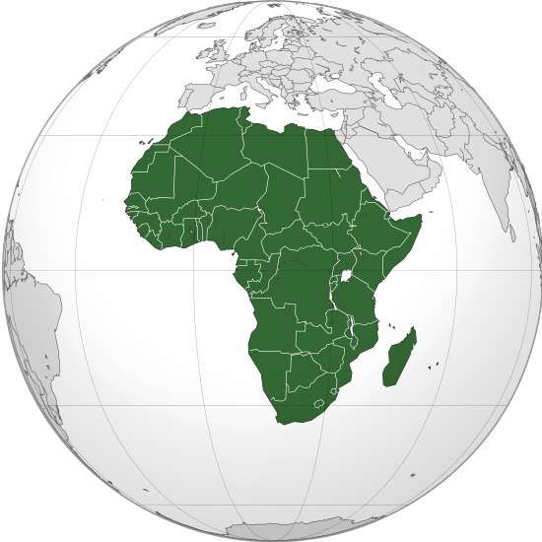
Stealth malaria? Pfhrp2/3 deletions and malaria rapid diagnostic testing
Jonathan B. Parr, MD, MPH
Assistant Professor
Infectious Disease Epidemiology and Ecology Lab
UNC Division of Infectious Diseases
ideelresearch.org

Slide 2
First things first
Open R Studio
In the Console, type:
install.packages("devtools")
library(devtools)
install_github("OJWatson/hrp2malaRia")
library(hrp2malaRia)
Notes:
http://www.who.int/mediacentre/factsheets/fs094/en/
Funds from Global Fund, Gates, and others

Slide 3
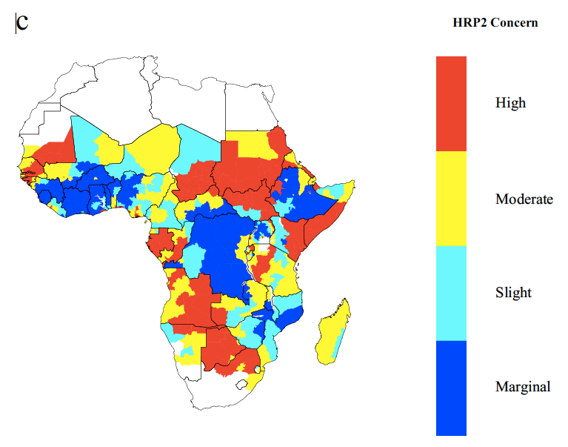
Outline
Background
Malaria
Rapid diagnostic tests (RDTs)
Pfhrp2/3 deletions
Evolution and spread of “stealth” pathogens?
Modelling lab
Watson pfhrp2/3 model
Simulating reality
Map: Watson OJ et al, eLife 2017

Slide 4
Background:
© Copyright Worldmapper.org / Sasi Group (University of Sheffield) and Mark Newman (University of Michigan).

Slide 5
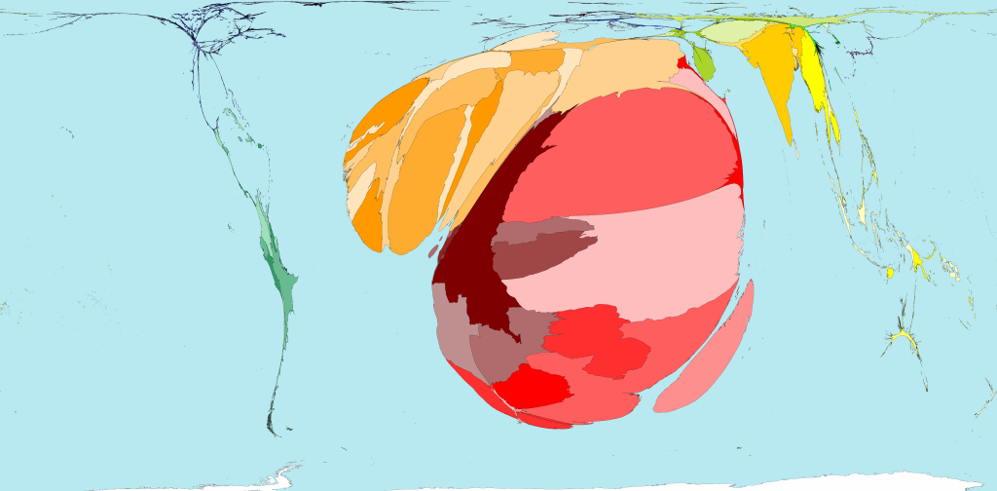
216 million cases in 2016
WHO World Malaria Report 2017
© Copyright Worldmapper.org / Sasi Group (University of Sheffield) and Mark Newman (University of Michigan).

Slide 6
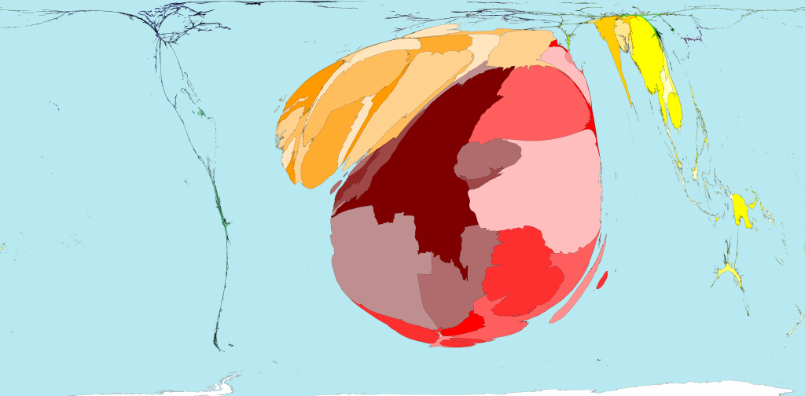
445,000 deaths in 2016 (91% in Africa)
WHO World Malaria Report 2017
© Copyright Worldmapper.org / Sasi Group (University of Sheffield) and Mark Newman (University of Michigan).

Slide 7
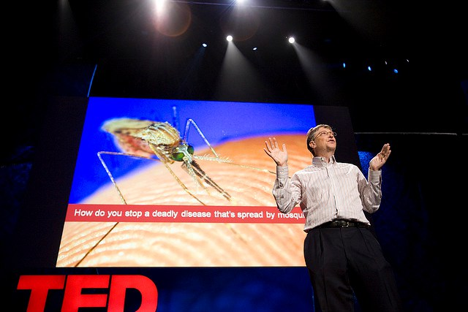
Background: Improvements
Significant recent improvements
Mortality rates have fallen by 48% since 2000
Why?
$$$$$ for:
Insecticidal bed nets
Indoor residual spraying
Better availability of artemisinin combination therapies
Better availability of rapid diagnostic tests
Photo credit: Steve Jurvetson (creative commons)
Notes:
http://www.who.int/mediacentre/factsheets/fs094/en/
Funds from Global Fund, Gates, and others

Slide 8
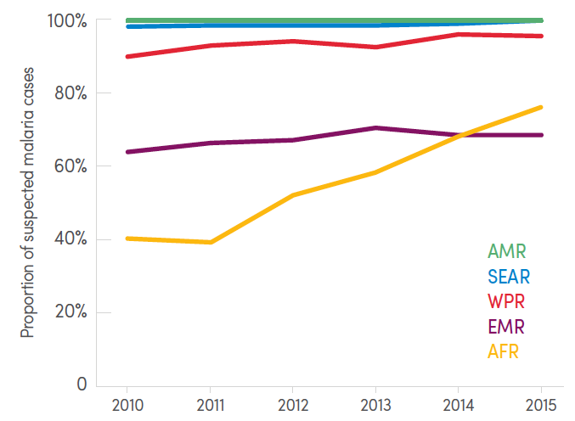
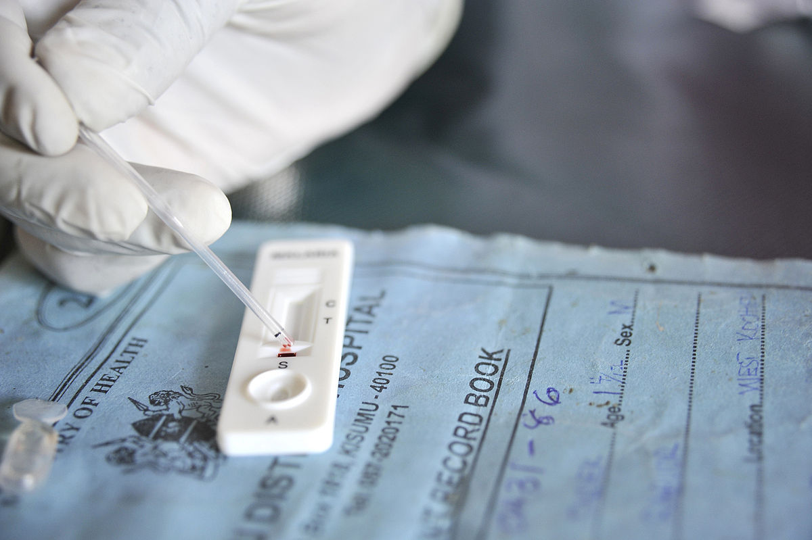
Background: RDTs
Basics
Most target histidine-rich protein 2 (HRP2), a falciparum-specific antigen
More sensitive and heat stable than alternatives (e.g. LDH)
WHO: use HRP2 in Africa
Proportion of suspected malaria cases attending public health facilities who receive a diagnostic test
RDT uptake
312 million units delivered (2016)
>$150 million investment, primarily in Africa (2014)
74% of all diagnostic testing for suspected malaria in Africa (2015)
PATH 2014, WHO World Malaria Report 2016, Photo USAID (public domain)

Slide 9

Genes of Interest in pfhrp2 Locus
pfhrp2:
Located on chromosome 8
Contains numerous histidine repeats (key trait exploited by RDTs for detection)
Mal8P1_230 and Mal8P1_228 are the immediate upstream and downstream genes respectively.
5535 bp
6490 bp
1063 bp
Mal8P1.231
pfhrp2
1984 bp
Mal8P1.228
Heat Shock
1022 bp
Mal8P1.230
Hypothetical
/Pseudogene
Slide courtesy of Venkatachalam Udhayakumar, adapted

Slide 10
Stealth parasites?
Photos: USAID (public domain), James Gathany (public domain)

Slide 11
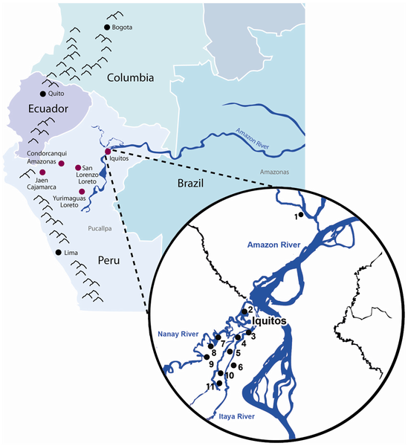
Background: pfhrp2 deletions
First: Peruvian Amazon (2010)
148 stored samples from 2003-07
41% pfhrp2-deleted
70% pfhrp3-deleted
9 samples from Iquitos
89% pfhrp2-deleted
Later:
Reported in Colombia, Mali, Senegal, India, China
Small numbers tested, with 0-2% prevalence
Cheng et al. Malar J 2014. Figure from Gamboa D et al. PLoS ONE 2010, 5(1): e8091.
Notes:
Gamboa paper summary:
- Of 148 stored samples from subjects with symptomatic malaria in various studies conducted 2003-2007:
61 (41%) pfhrp2-deleted, 103 (70%) pfhrp3-deleted
- Of 9 microscopy-positive, symptomatic cases in Iquitos:
8 (89%) were pfhrp2-deleted
Used PCR assays for 5 other genes, ELISAs for HRP2, pLDH, and aldolase
Microsatellite analysis:
Present in 4 of 5 clonal lineages (identified using STRUCTURE and neutral microsatellites)

Slide 12
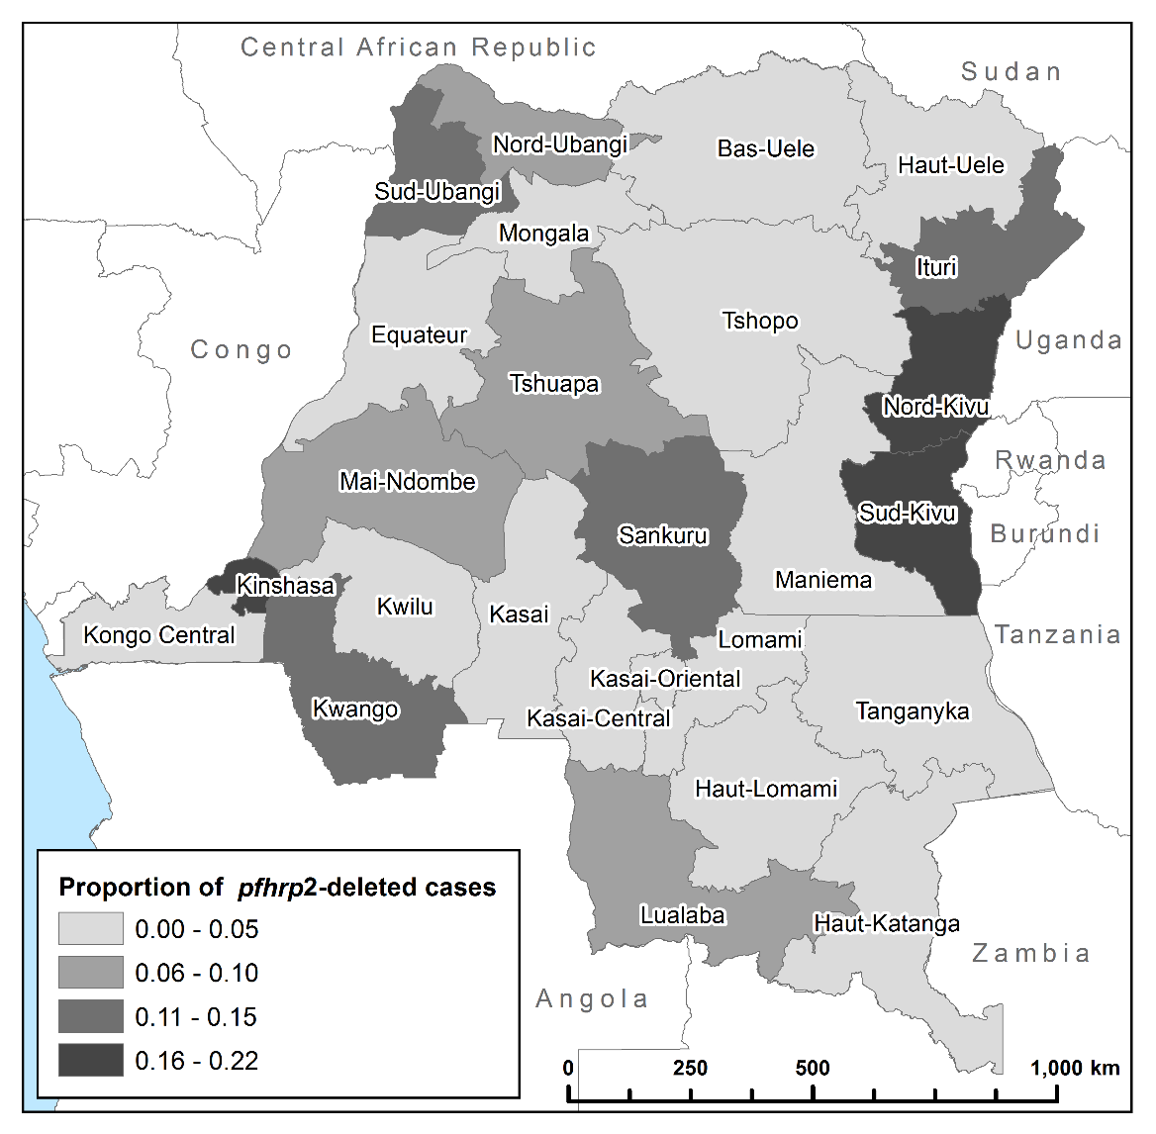
DRC - Results
First national survey
6.4% (n=149) prevalence among asymptomatic, PCR-pos subjects had a pfhrp2 deletion.
Only 5 (3.4%) of these 149 also had a pfhrp3 deletion
Spatial clustering
Deletions more common in areas of low malaria prevalence (e.g. 21.9% in Kinshasa)
Parr JB, Verity R, et al., J Inf Dis 2017

Slide 13
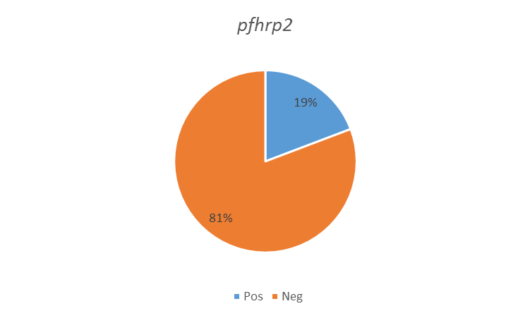
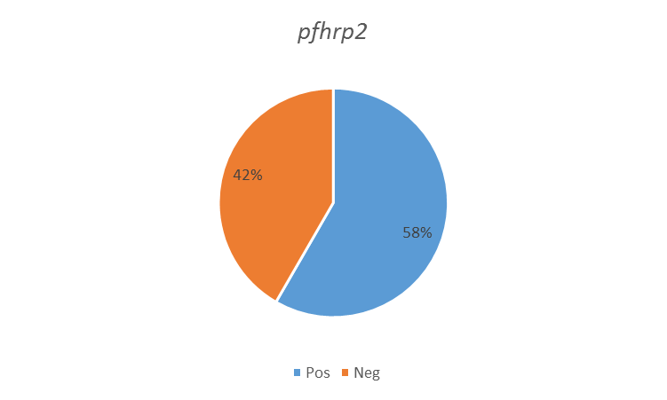
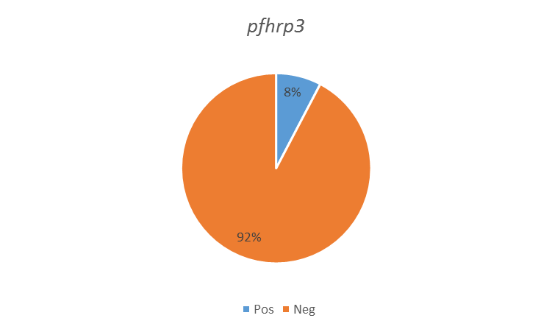
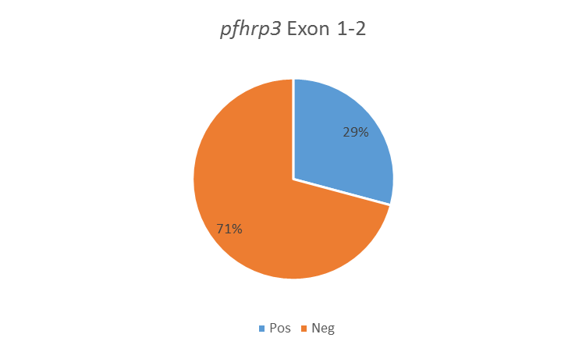
pfhrp2/pfhrp3 deletions in Eritrea
Study conducted in 2016
Ghindae Hospital
Massawa Hospital
RDTs implemented in 2006: SD Bioline Pf/Pv 05FK80
Defects reported in 2014-2015
Eritrea MOH team: Araia Berhane; Selam Mihreteab; Salih Mohamed; Filmon Hagos
Australian Army Malaria Institute-QIMR Berghofer: Karen Anderson, Qin Cheng
WHO: Jane Cunningham, Anderson Chinorumba
n = 26
1,381-89,120 P/µL
n = 24
32 – 25,760 P/µL
Slide courtesy of Qin Cheng. ASTMH 2016, Berhane poster #879.

Slide 14

Mapping selection pressure for pfhrp2-deletion
Prevalence in children ⁶ 2-10 years old
Proportion of people ⁷ seeking treatment
Slide courtesy of Oliver Watson (Watson OJ et al., ELife 2017)
Notes:
10s

Slide 15
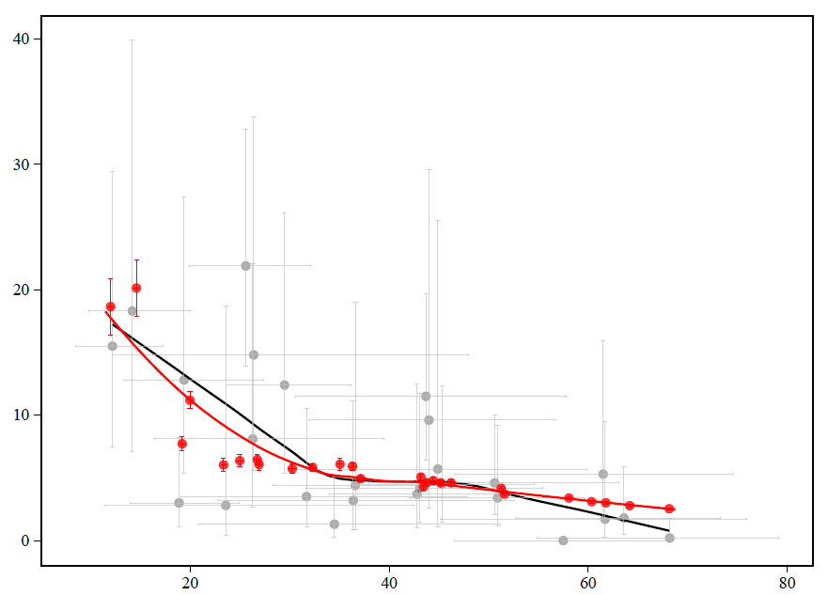
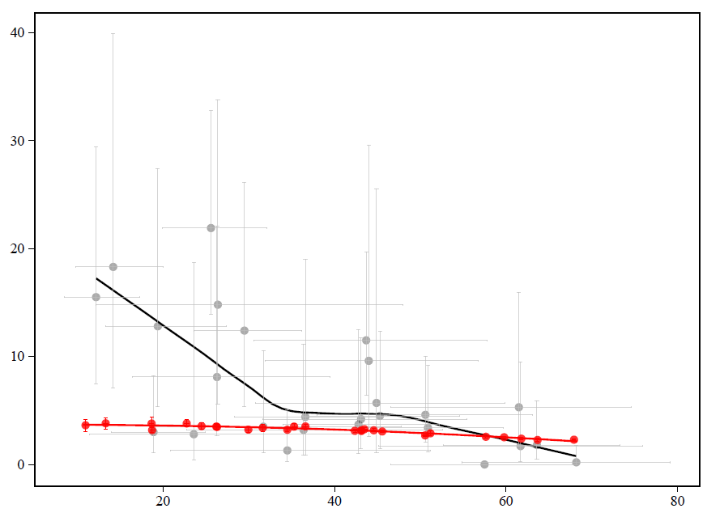

Deletion pattern by transmission level
Significantly higher proportion of deleted samples in low transmission areas
Can only be explained by selection through RDT-guided treatment decisions
With selection
Without selection
North-Kivu
South-Kivu
North-Kivu
South-Kivu
Proportion of individuals infected with only pfhrp2-deleted parasites
DRC
Simulation
PCR Prevalence in children 6-59 months old
Slide courtesy of Oliver Watson (Watson OJ et al., ELife 2017)
Notes:
1 min

Slide 16
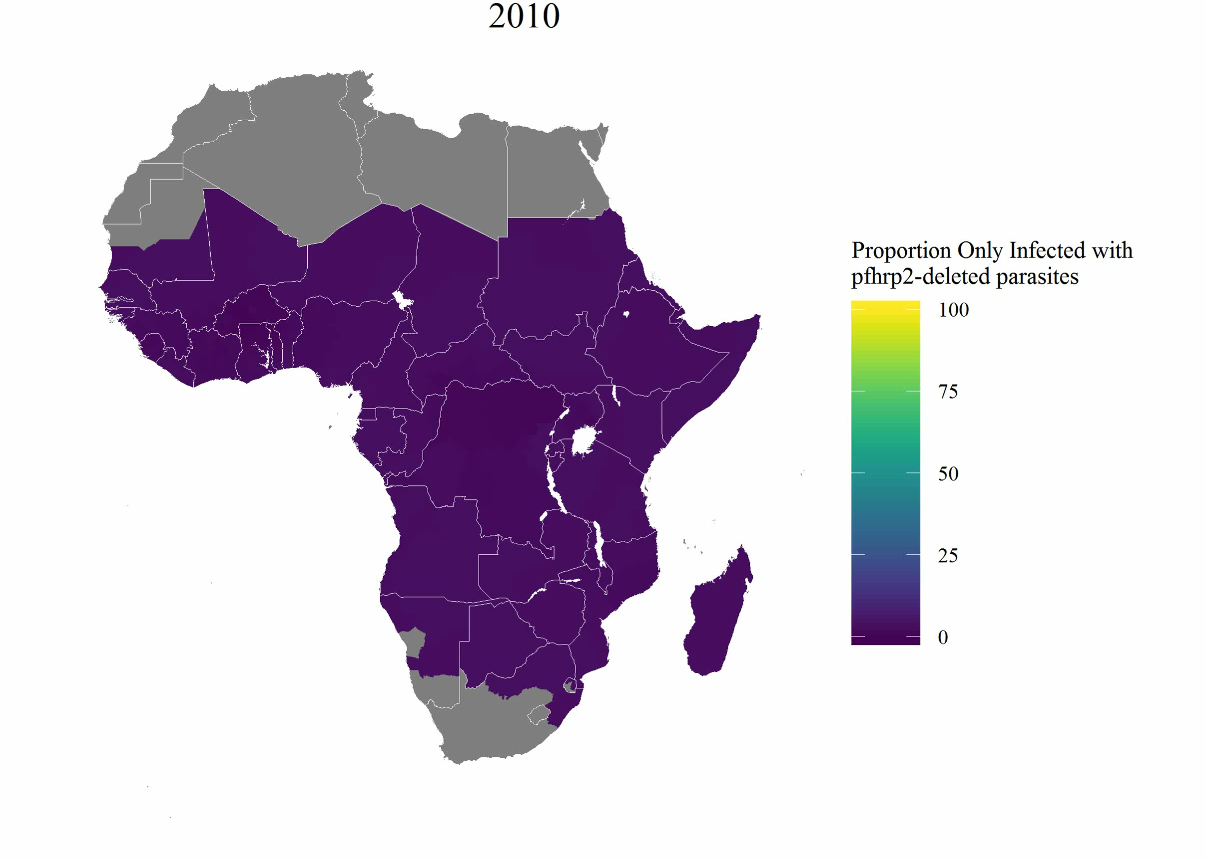
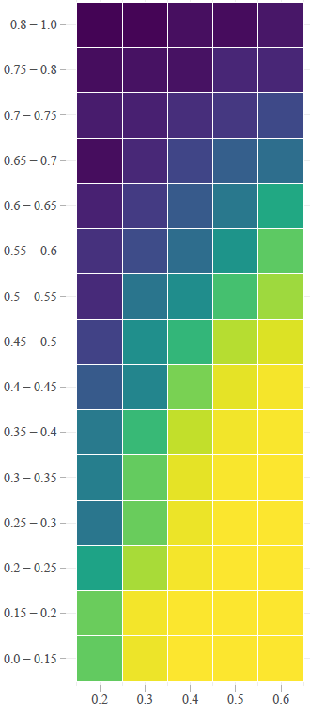
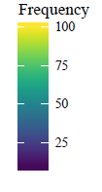
Modelling selection-driven spread
Frequency of strains that are pfhrp2-deleted
Proportion of population
only infected with
pfhrp2-deleted parasites
Prevalence of Malaria
Proportion of people
seeking treatment
* Model assumes no change in prevalence and treatment coverage – spread therefore conservative
Slide courtesy of Oliver Watson (Watson OJ et al., ELife 2017)
Notes:
40s

Slide 17
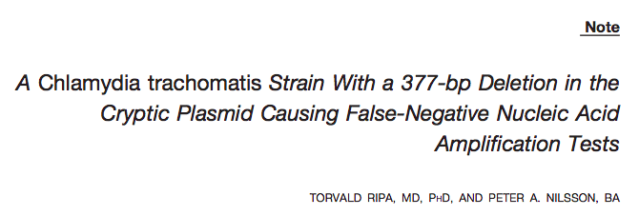
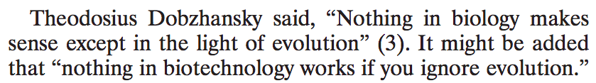
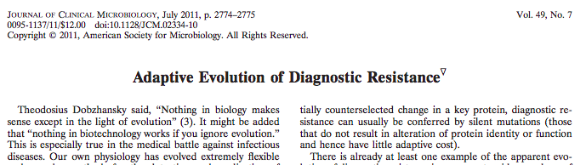
“Diagnostic resistance”
Sex Trans Dis 2007, Metzgar D, J Clin Micro 2011.
Notes:
PMID: 17483723
Sweden began using Ct NAATs in the mid-1990’s
They noticed a sudden drop in cases by 25% in 2006
Investigation revealed a clonal strain with a 377bp deletion at the target of the NAAT

Slide 18
Outline
Background
Malaria
Rapid diagnostic tests (RDTs)
Pfhrp2/3 deletions
Evolution and spread of “stealth” pathogens?
Modelling lab
Watson pfhrp2/3 model
Simulating reality
Map: Watson OJ et al, eLife 2017

Slide 19
R modelling exercise

Slide 20
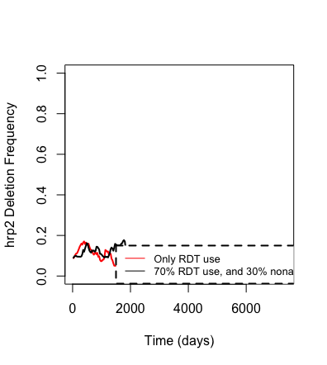
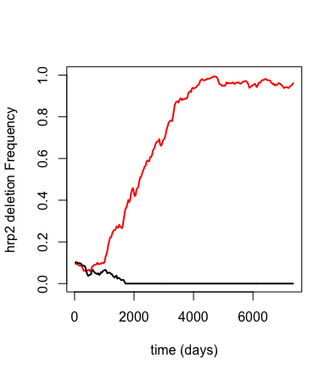
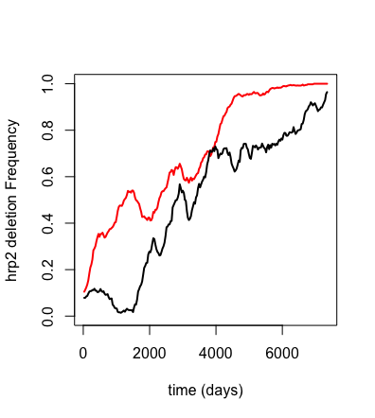
Run-to-run variability
Notes:
Run-to-run variability in the model

Slide 21
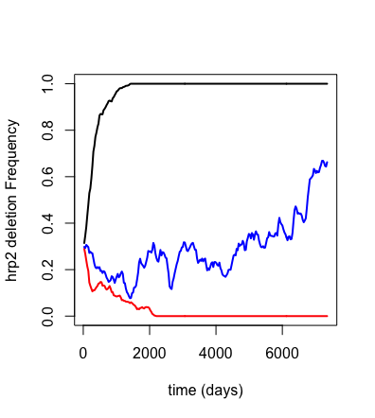
South America simulation:
Big fitness advantage
r2 <- hrp2_Simulation(N=2000, years=20, rdt.det = 0, EIR=1/365, microscopy.use = 1, strains.0=2, fitness = 2)
Slight fitness advantage
r3 <- hrp2_Simulation(N=2000, years=20, rdt.det = 0, EIR=1/365, microscopy.use = 1, strains.0=2, fitness = 1.05)
No fitness advantage
r <- hrp2_Simulation(N=2000, years=20, rdt.det = 0, EIR=1/365, microscopy.use = 1, strains.0=2, fitness = 1)

Slide 22
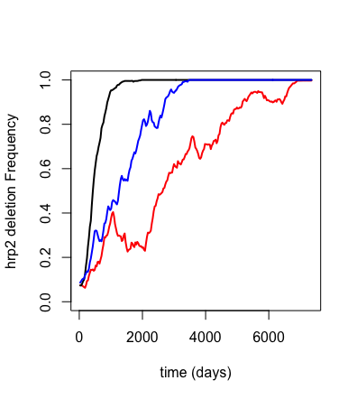
Africa simulation:
Big fitness advantage
r2 <- hrp2_Simulation(N=2000, years=20, rdt.det = 0, rdt.nonadherence = 0.2, EIR=1/365, microscopy.use = 0, strains.0=10, fitness = 2)
Slight fitness advantage
r3 <- hrp2_Simulation(N=2000, years=20, rdt.det = 0, rdt.nonadherence = 0.2, EIR=1/365, microscopy.use = 0, strains.0=10, fitness = 1.05)
No fitness advantage
r <- hrp2_Simulation(N=2000, years=20, rdt.det = 0, rdt.nonadherence = 0.2, EIR=1/365, microscopy.use = 0, strains.0=10, fitness = 1)

Slide 23
Putting it together
South America and Africa have different malaria diagnostic approaches and parasite populations
Selective pressure likely exists in Africa due to the high rate of RDT-based treatment.
Fitness may be a driver of these gene deletions, but diagnostic policies play an important role.
South America
Africa

Slide 24
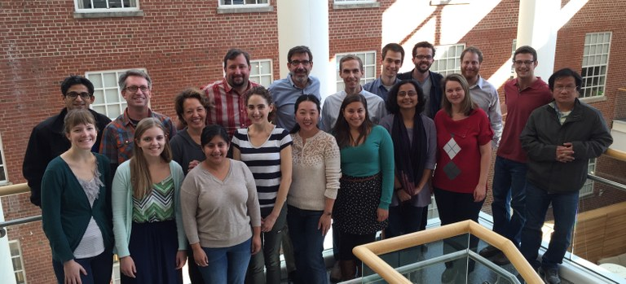
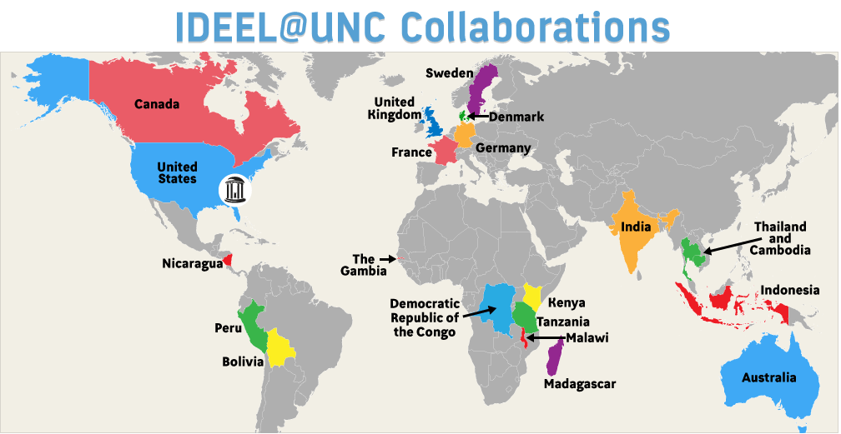
Thank you!
Jonathan B. Parr, MD, MPH
jonathan_parr@med.unc.edu
www.ideelresearch.org

Slide 26
Malaria background
Caused by Plasmodium parasites
Plasmodium falciparum causes most malaria deaths
Transmitted by Anopheles mosquitos
2016 WHO estimates
216 million cases of malaria worldwide
445,000 deaths, primarily in Africa (91% of all deaths)
2013 Global Burden of Disease estimates
#8 for life years lost
#4 among infectious diseases (after lower respiratory tract infections, diarrheal diseases, and HIV/AIDS)
WHO World Malaria Report 2017; Lancet 2014; Photo James Gathany (public domain)
Notes:
http://www.who.int/mediacentre/factsheets/fs094/en/

Slide 27
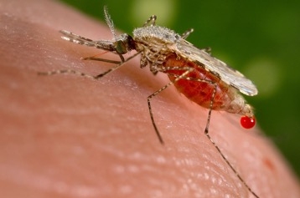
Malaria

Slide 28
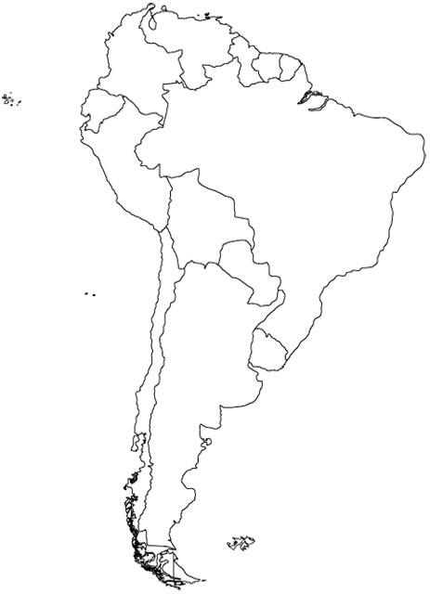

Distribution of pfhrp2- and pfhrp3-negative P. falciparum isolates in South America
Suriname
0%
0%
(N=97)
14.1%
3.8%
(N=78)
French Guyana
No deletion
(N=78)
7 %
45%
(N=465)
Guyana
Colombia
0%
50.8%
(N=59)
31%
38%
(N=84)
Para
33.3 %
53.8%
(N=93)
Acre
Peru
Rondonia
7%
22%
(N=61)
15%
30%
(N=204)
Brazil
Bolivia
4 %
68%
(N=25)
Murillo Solano C et al.,
PLoS One. 2015 Jul 7;10(7):e0131576
Dorado EJ et al.,
PLoS One.2016 11(9): e0163137.
Akinyi Okoth et al.,
PLoS One. 2015 May 15;10(5):e0126805
Trouvay M et al.,
PLoS One. 2013 Sep 23;8(9):e74269
Slide courtesy of Venkatachalam Udhayakumar

Slide 29
Modeling the spread of pfhrp2-deleted parasites
Proportion of individuals infected with only pfhrp2-deleted parasites
Observed DRC Dataset
Simulation
PCR Prevalence in children 6-59 months old
Slide courtesy of Oliver Watson, adapted (Watson OJ et al., ELife 2017)
Notes:
1 min

Slide 30
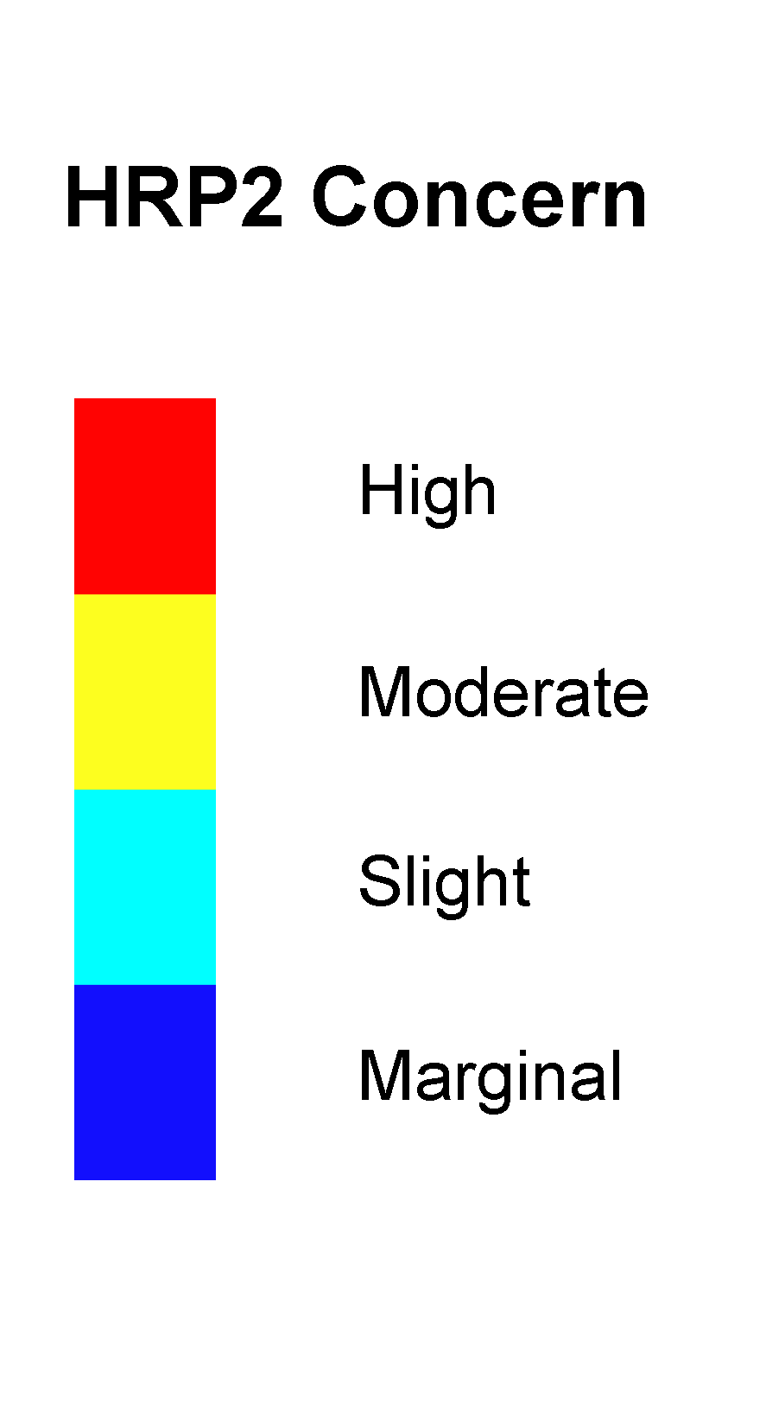
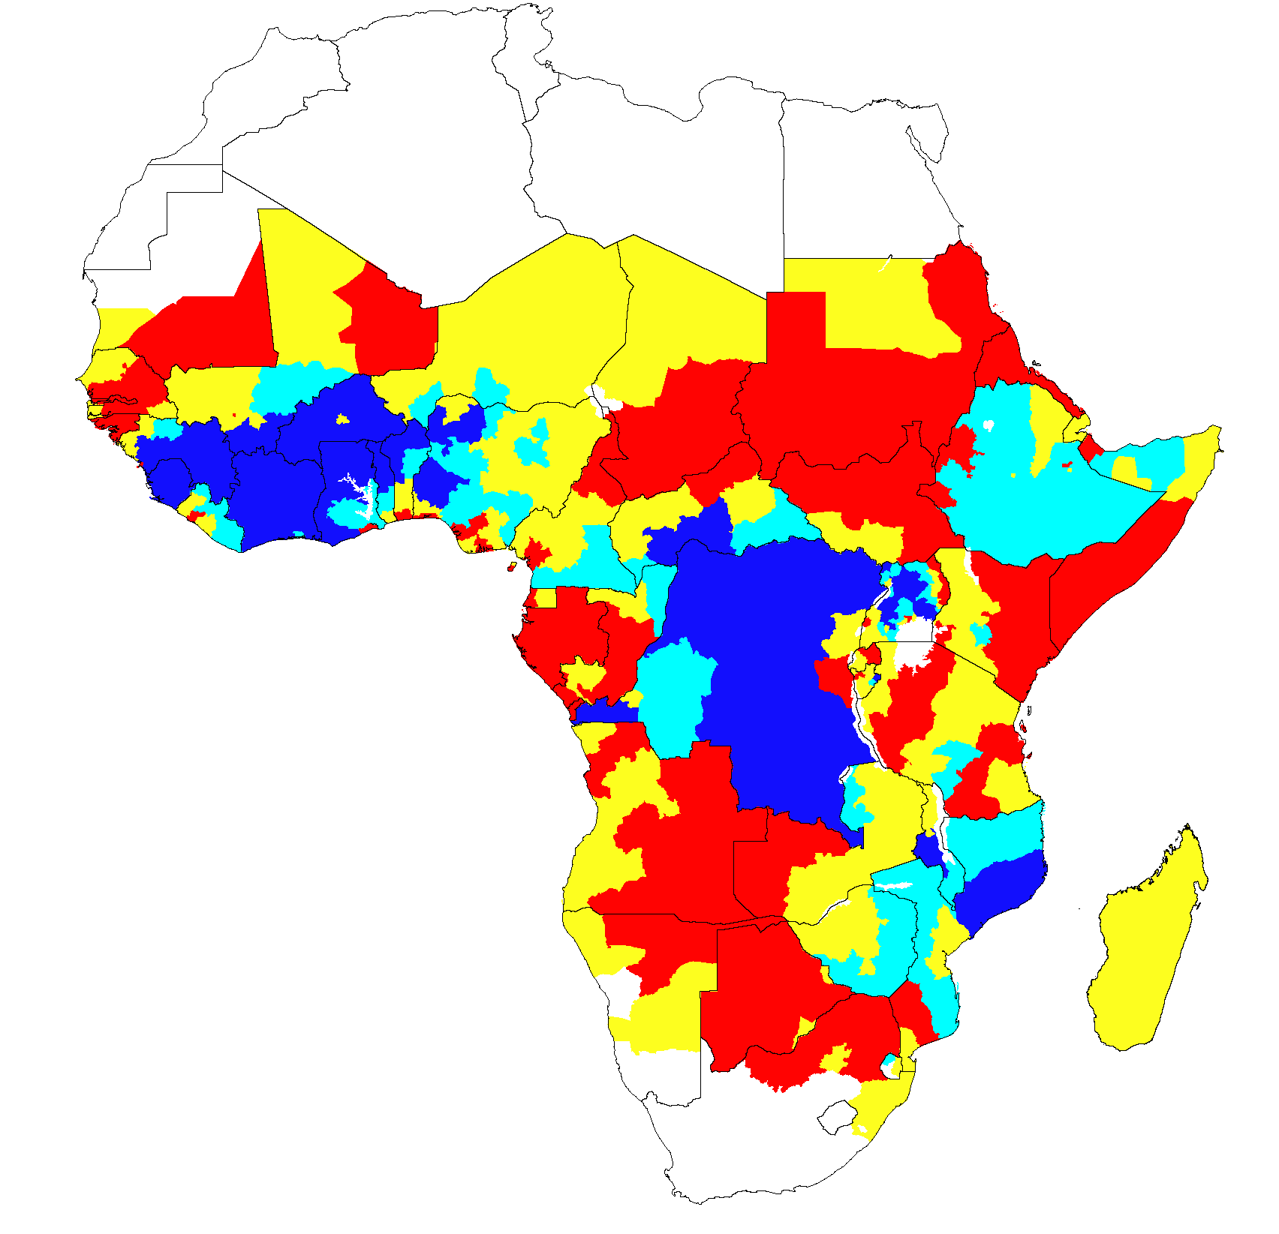
Modelled selection-driven spread
Fitted model identifies areas of concern for potential selection-driven spread in Africa
Highest concern: Low prevalence plus high RDT-guided treatment
Proportion of infected population possessing only pfhrp2-deleted mutants
>20% by 2016
>20% by 2022
>20% by 2030
<20% by 2030
Slide courtesy of Oliver Watson (Watson OJ et al., ELife 2017)
Notes:
50s

Slide 31
Modeling conclusions
An increased emergence of pfhrp2-deleted mutants can be explained by the introduction of testing by PfHRP2-based RDTs in the last 10 years.
The use of these RDTs will result in the greatest selection pressure in regions that have low malaria transmission and a high frequency of people seeking treatment.
Need for further genetic investigations in the regions identified as having a high HRP2 concern.
Slide courtesy of Oliver Watson, adapted (Watson OJ et al., ELife 2017)
Notes:
10s

